Slide 1
Microprocessors, Microcontrollers, and Embedded
Systems

Slide 2
Instructions
Form a group of 5 students
Left-out students will be assigned to groups on-the-spot
Each group should bring a windows laptop
The following softwares should be downloaded inside the laptop

Slide 3
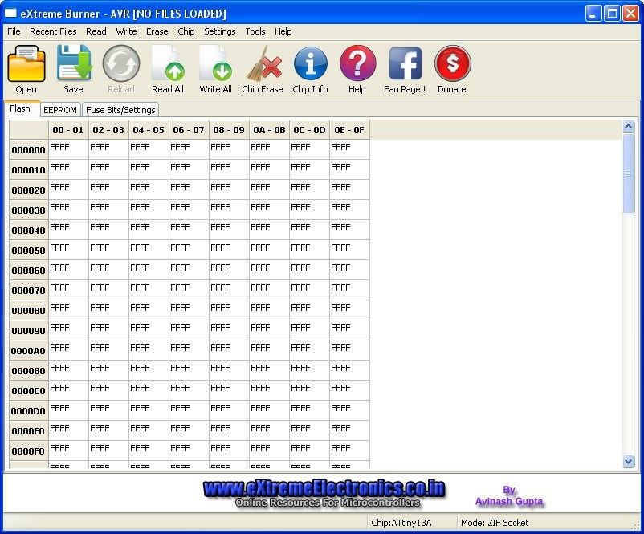
Softwares
https://extreme-burner-avr.software.informer.com/ - Extreme Burner

Slide 4
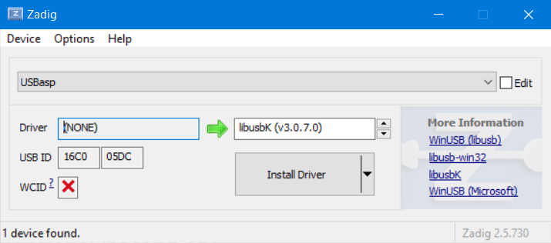
Softwares
https://zadig.akeo.ie/ - Zadig

Slide 5
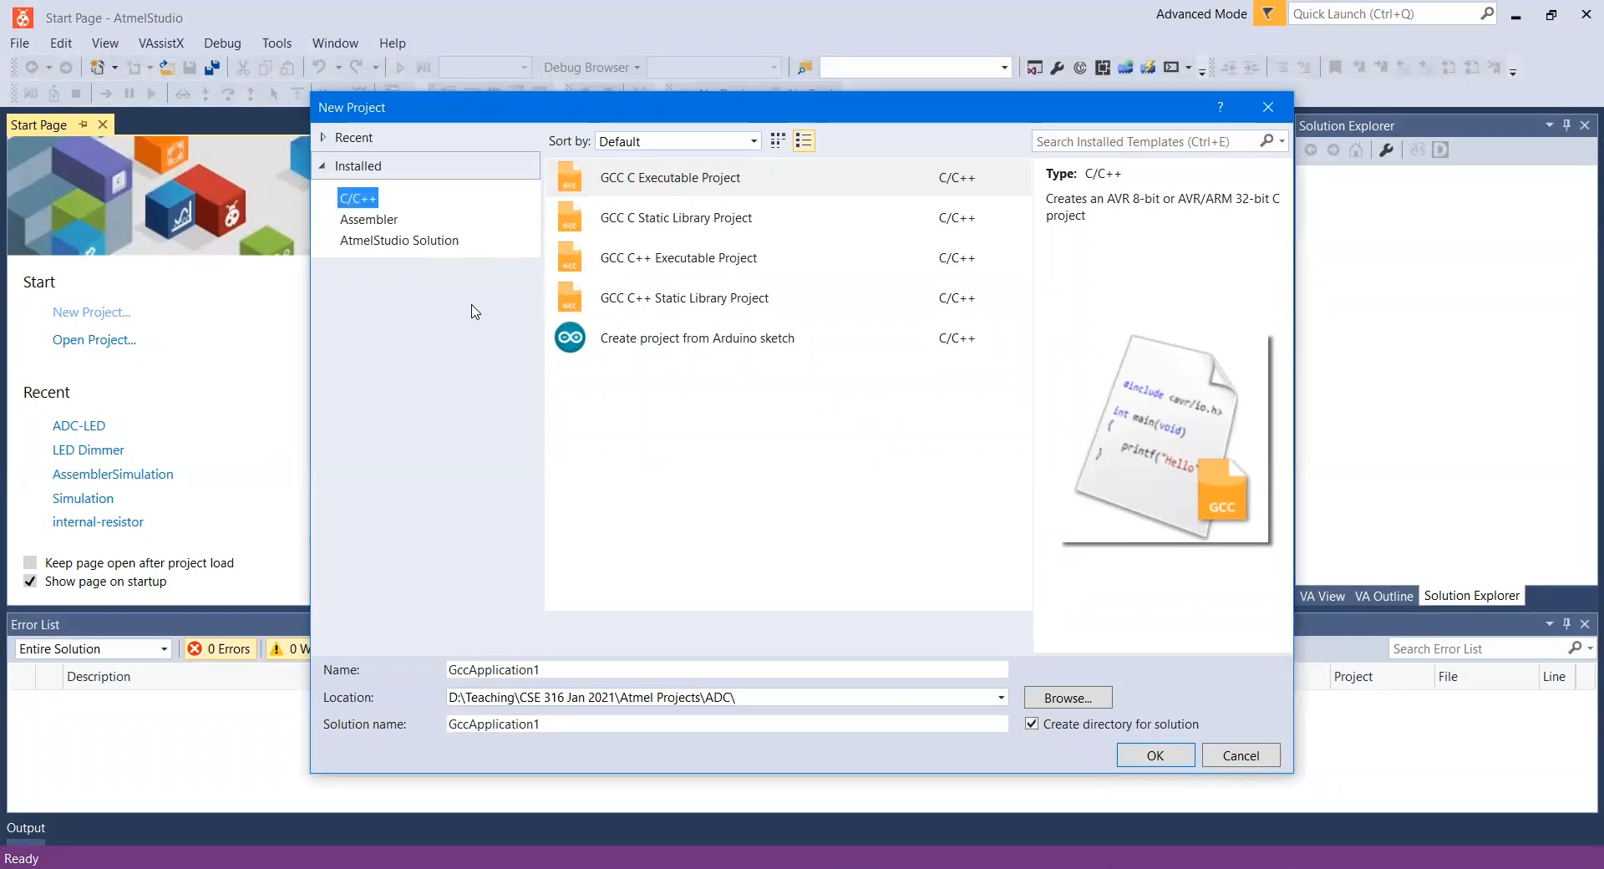
Softwares
https://www.microchip.com/en-us/tools-resources/develop/microchip-studio - Microchip Studio

Slide 6
Study
How a breadboard works
https://www.youtube.com/watch?v=mE33WpRWrXs
How a multimeter works
https://www.youtube.com/watch?v=ts0EVc9vXcs

Slide 7
More Study
Will be shown in the lab
You can study ahead
https://drive.google.com/file/d/1SMq_ac20-hbJk-iZYgz8RbI9gQPf-KzK/view

Slide 8
More More Study
Will not be shown
How to do simulation without actual components
https://drive.google.com/file/d/1o5E-Vx0ypAIfoTxLjELFex-lWbBnXYf-/view

Slide 9
☺

